Slide 1
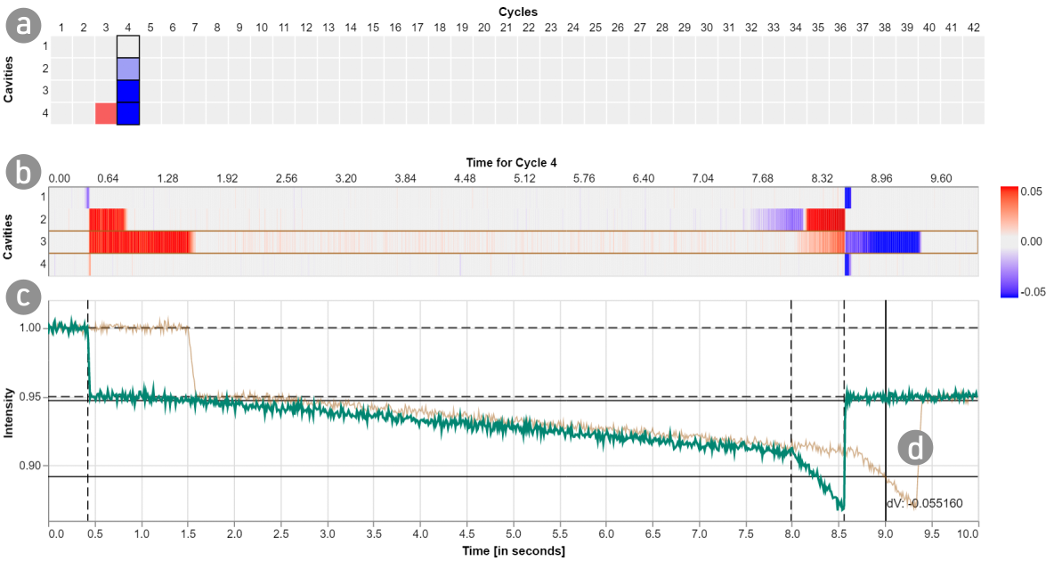



Visualizing and Monitoring the Process of Injection Molding
Christian A. Steinparz, Thomas Mitterlehner, Bernhard Praher, Klaus Straka, Holger Stitz, Marc Streit
http://injection-molding.jku-vds-lab.at/
christian.steinparz@jku.at

Slide 2
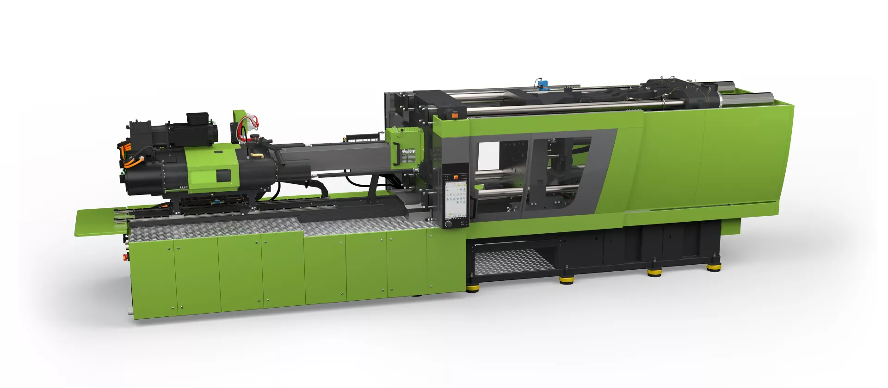
Injection Molding
Engel e-cap Injection Molding Machine

Slide 3

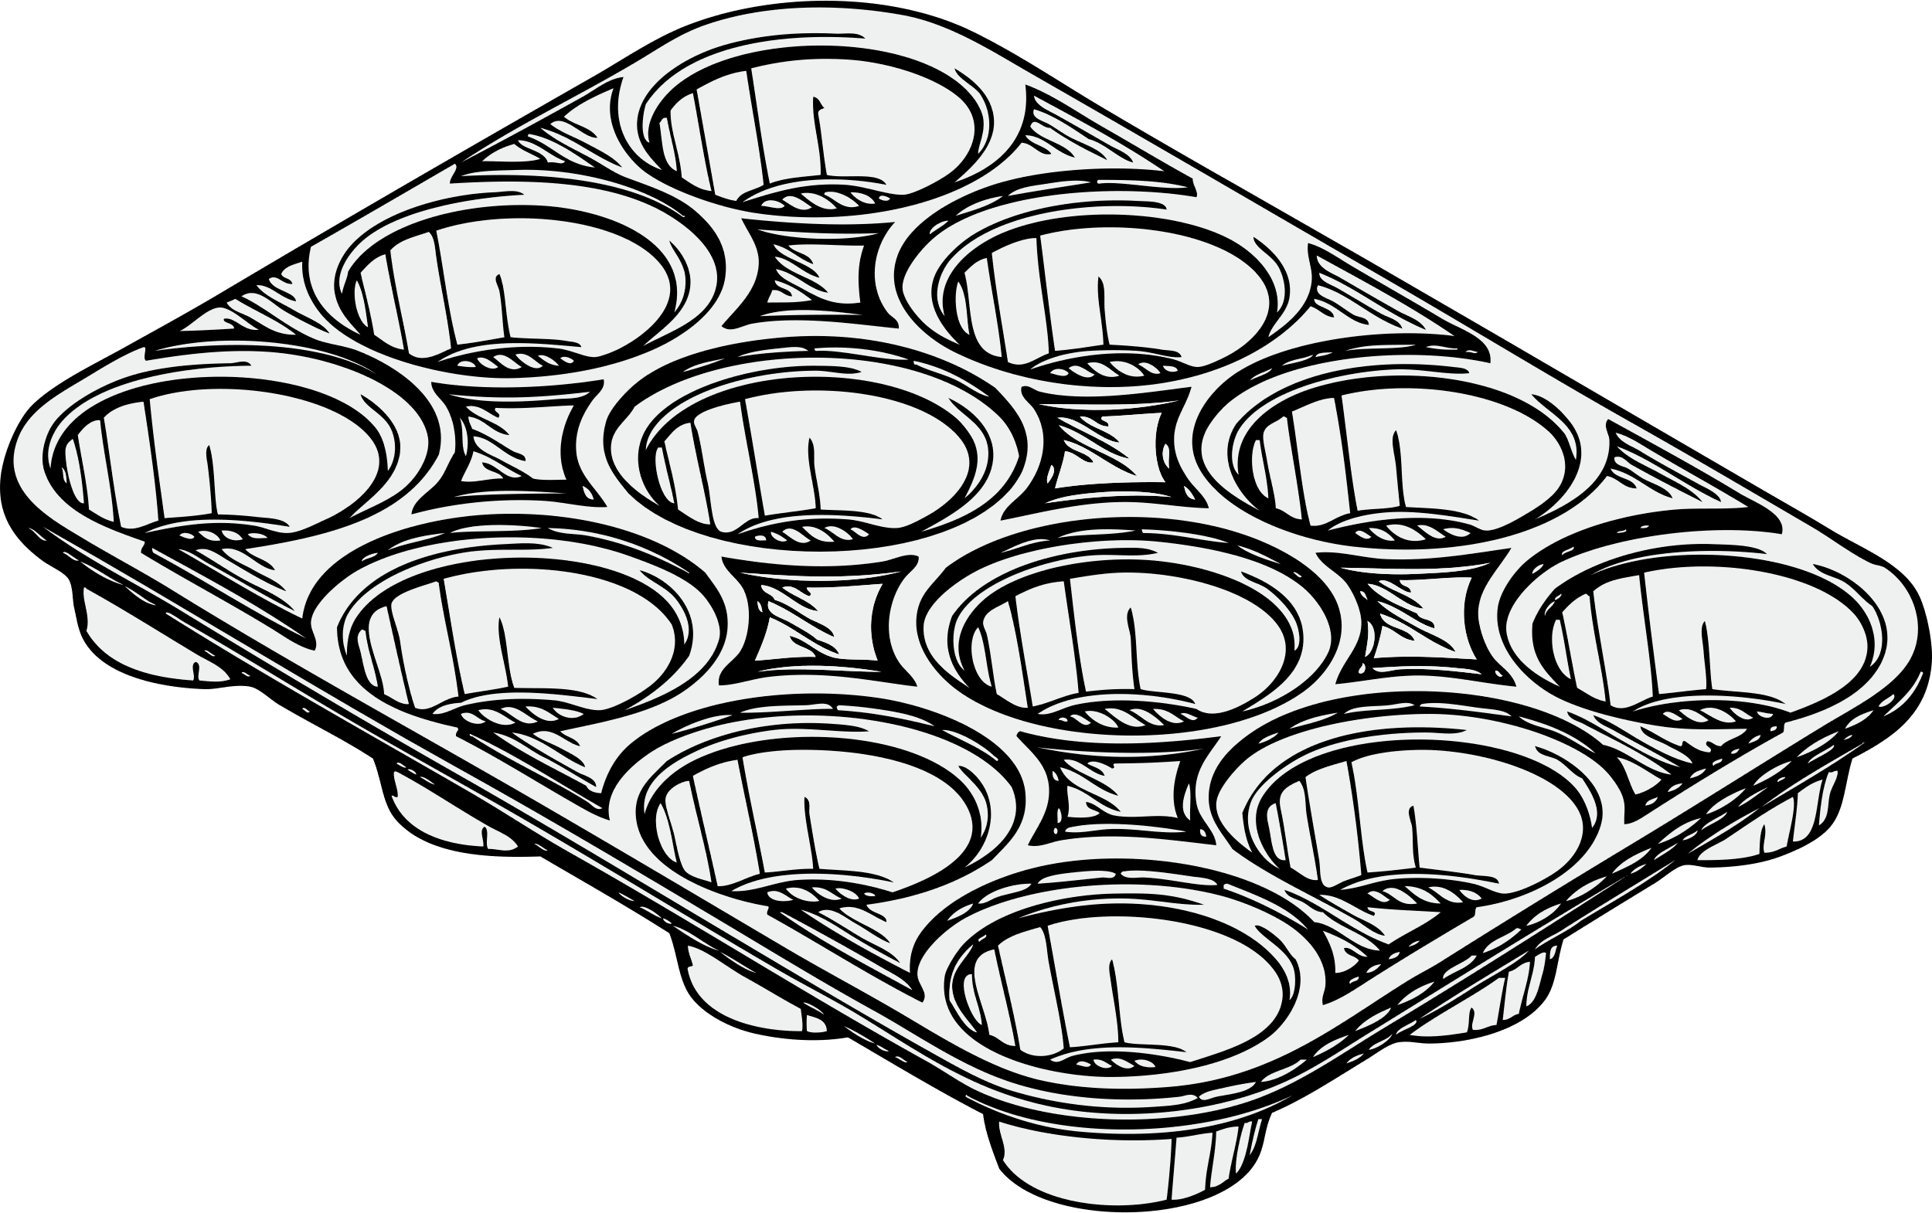

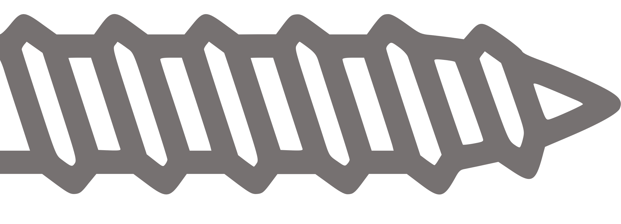
Injection Molding
Engel e-cap Injection Molding Machine

Slide 4

Injection Molding
…
Engel e-cap Injection Molding Machine

Slide 5
Injection Molding
…
Engel e-cap Injection Molding Machine

Slide 6
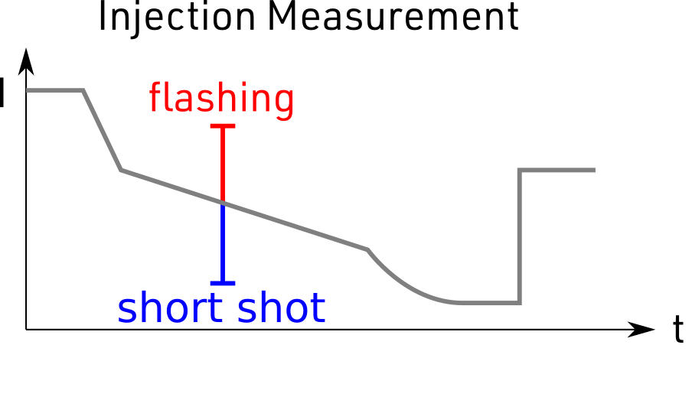
Injection Molding
Engel e-cap Injection Molding Machine

Slide 7
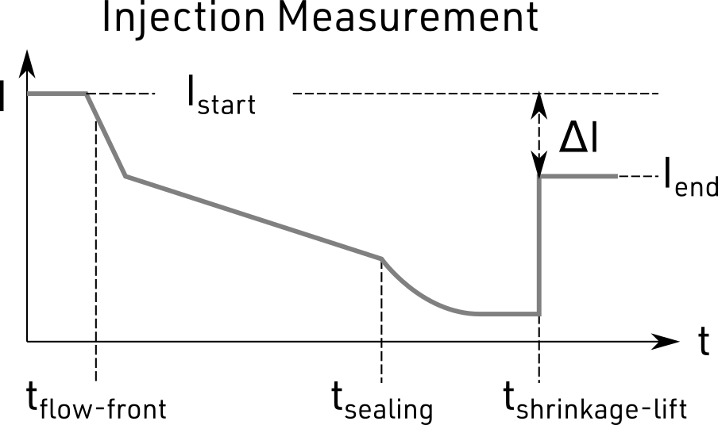
Injection Molding
Engel e-cap Injection Molding Machine

Slide 8
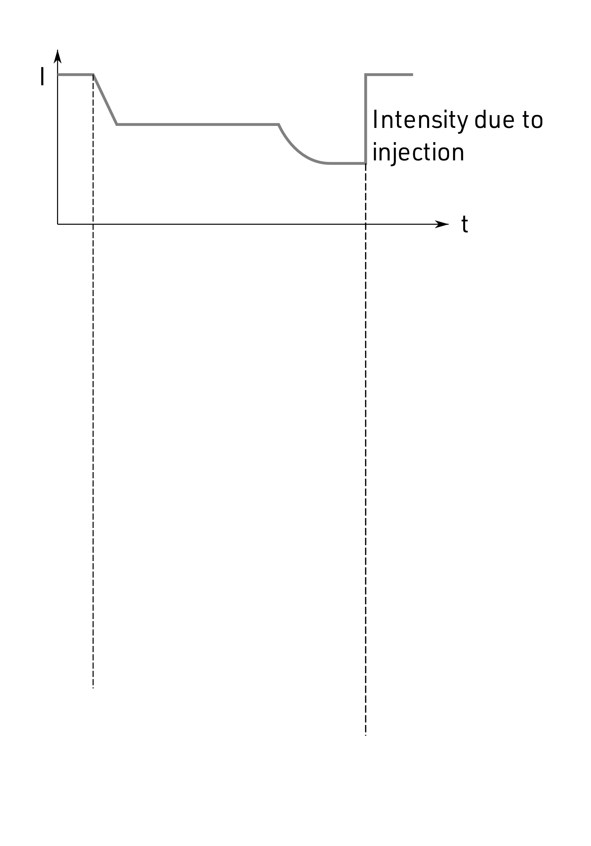
Metadata Example

Slide 9
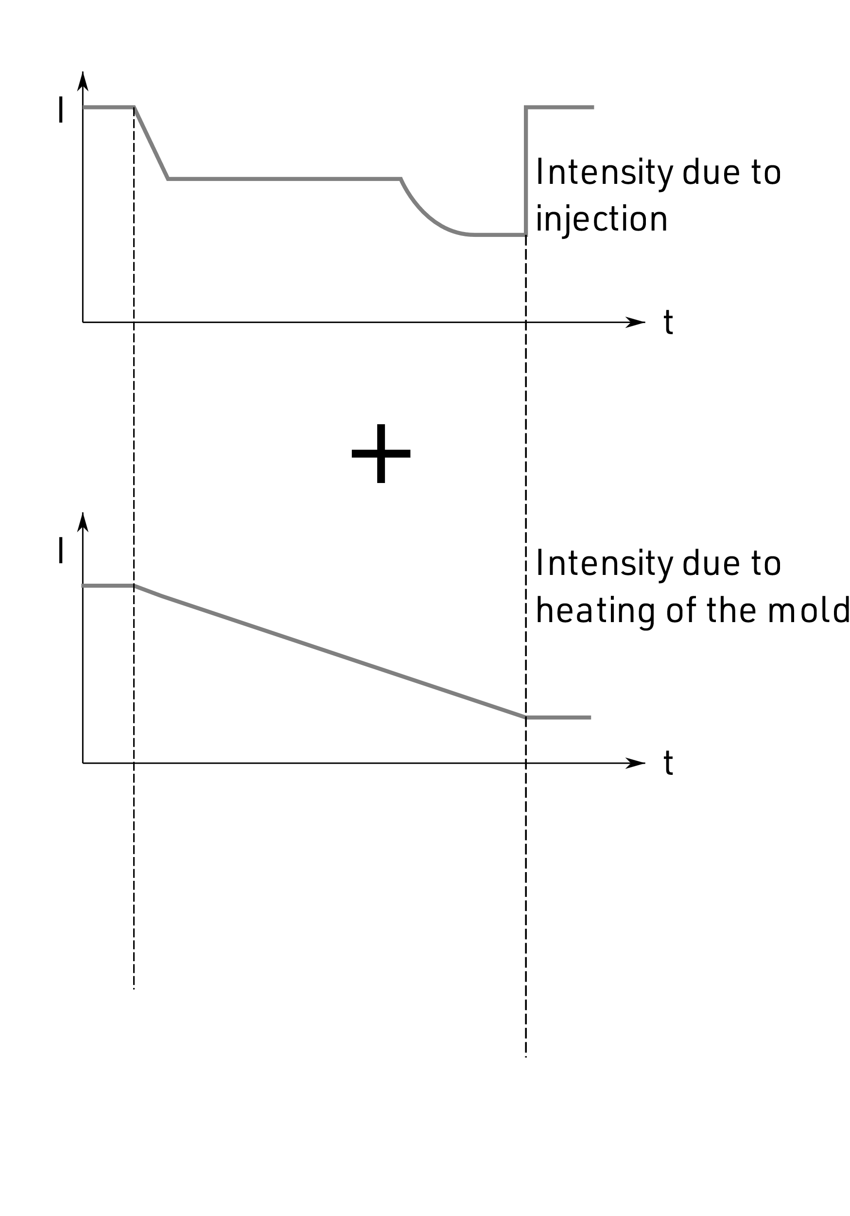
Metadata Example

Slide 10
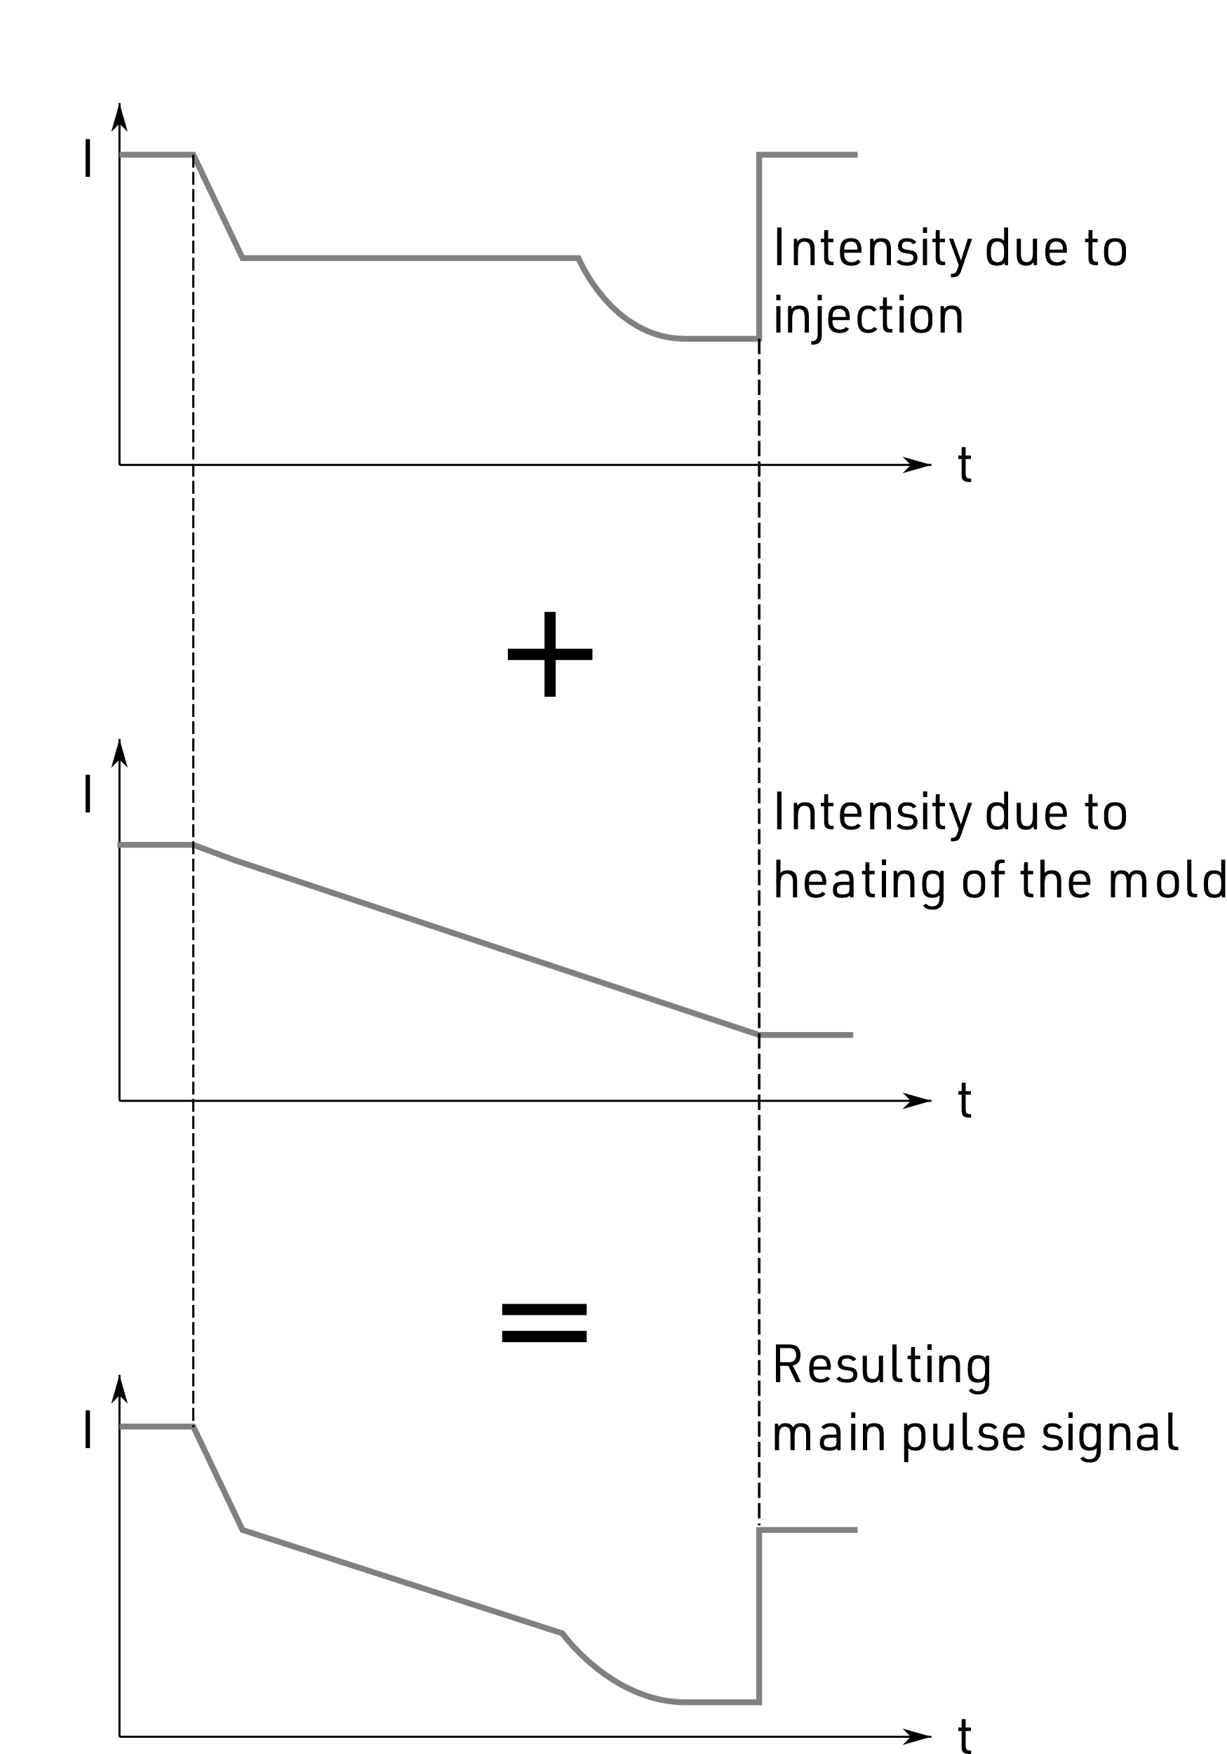
Metadata Example

Slide 11
Metadata Example

Slide 12
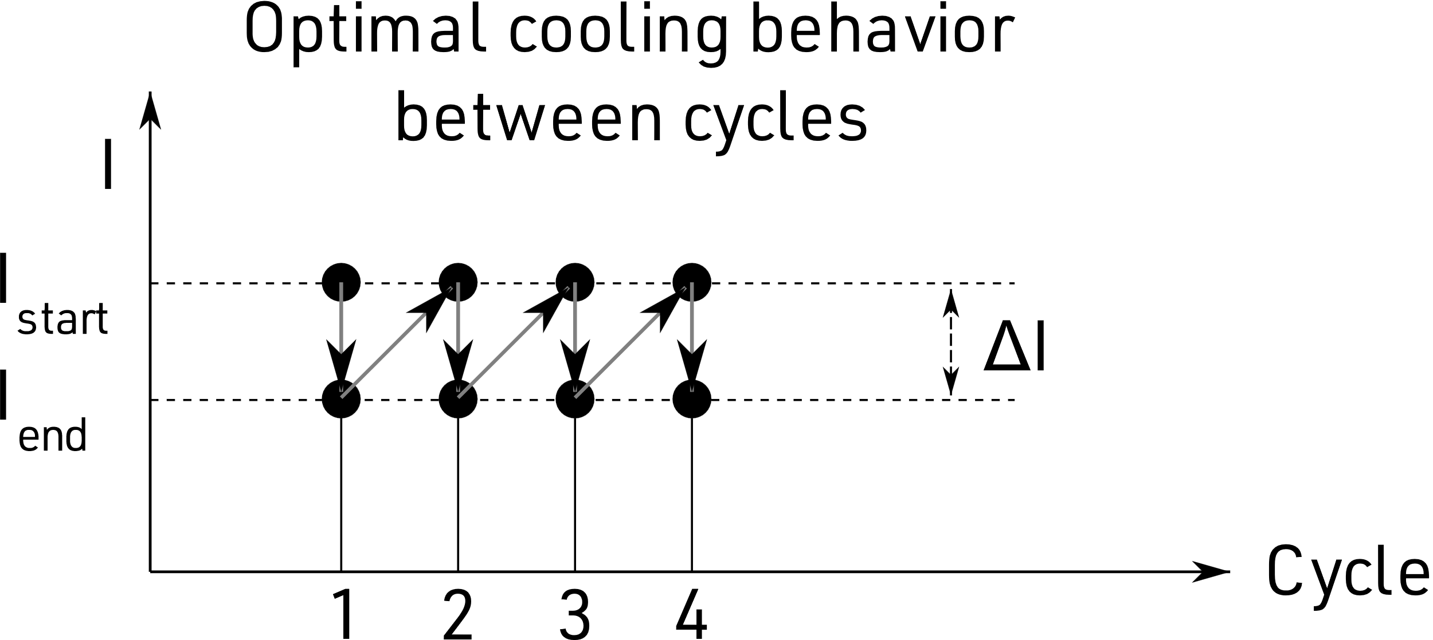
Metadata Example

Slide 13
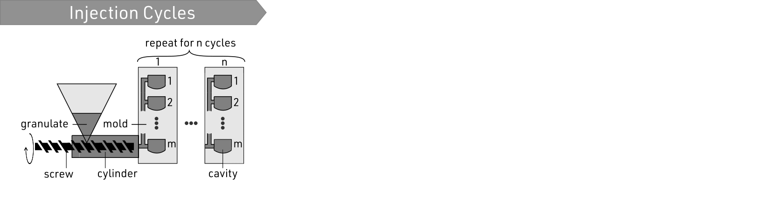
Visualization Workflow

Slide 14
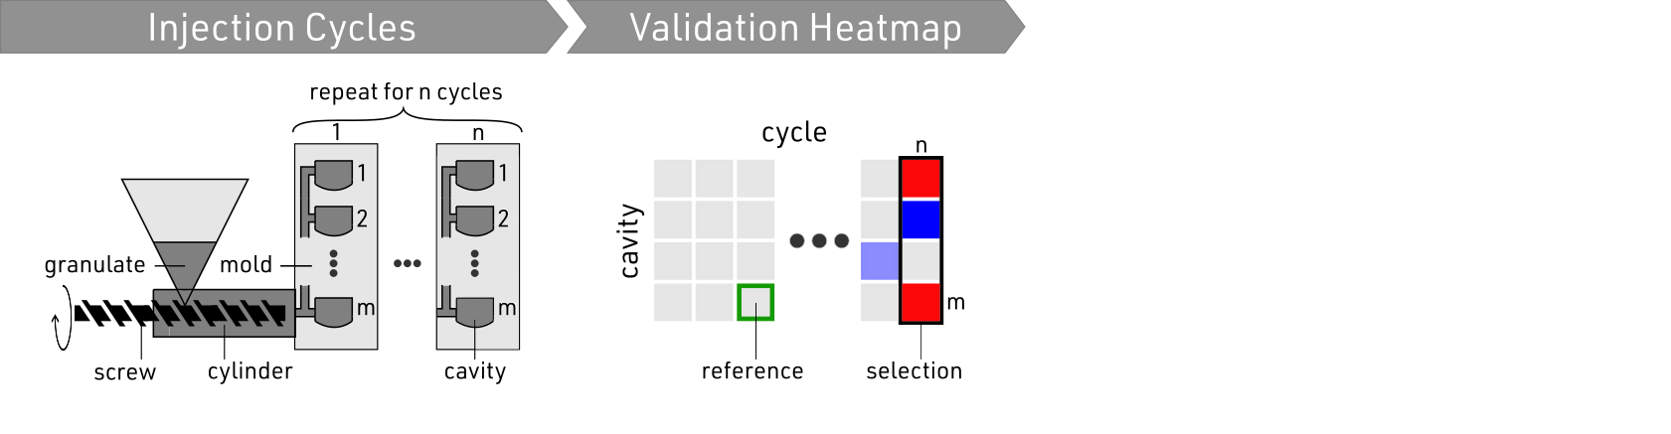
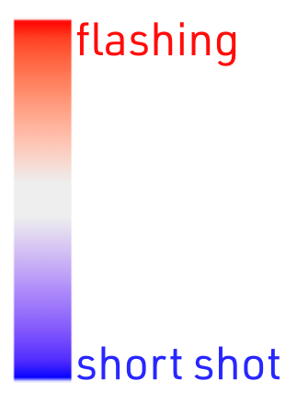
Visualization Workflow

Slide 15
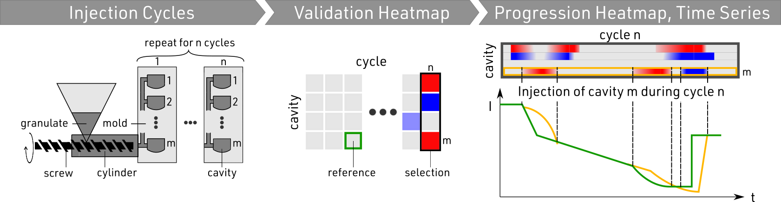
Visualization Workflow

Slide 16
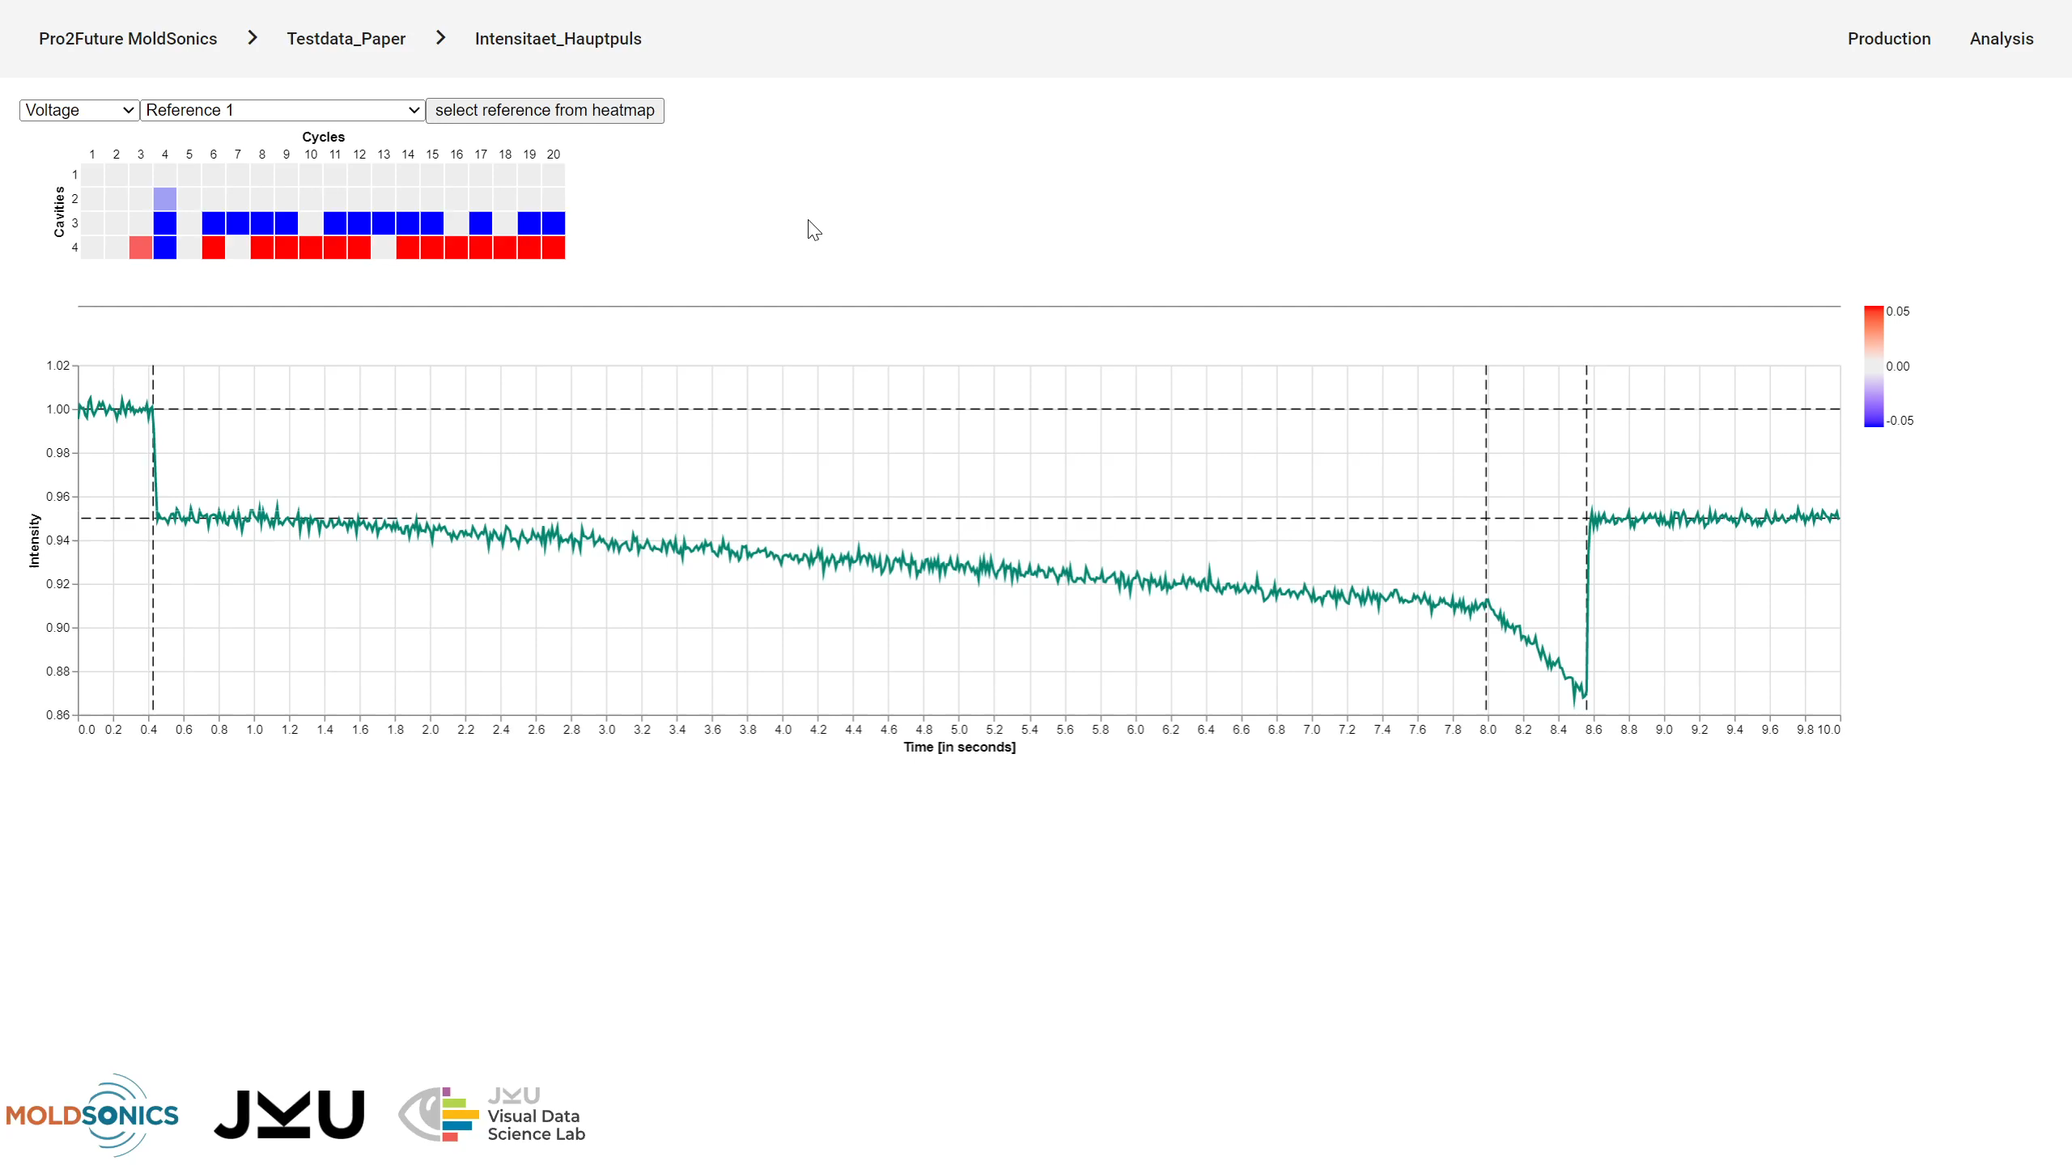
Visualization Workflow

Slide 17

Visualization Workflow

Slide 18
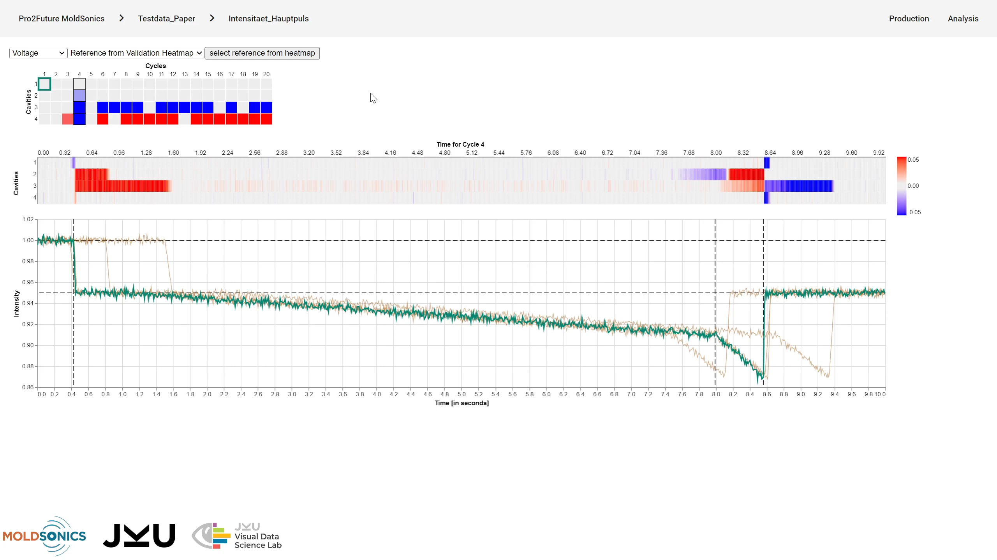
Visualization Workflow

Slide 19
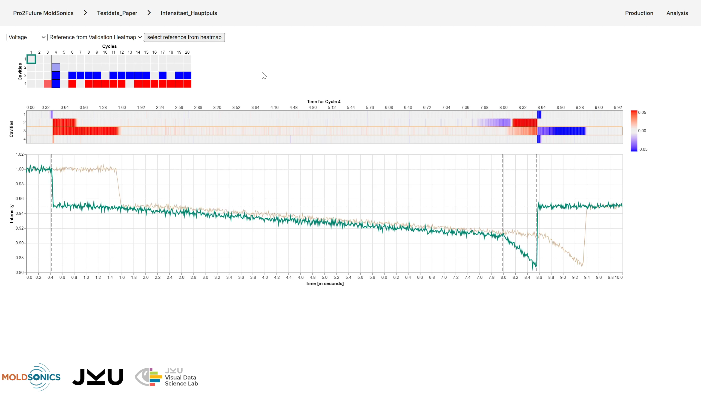
Visualization Workflow

Slide 20
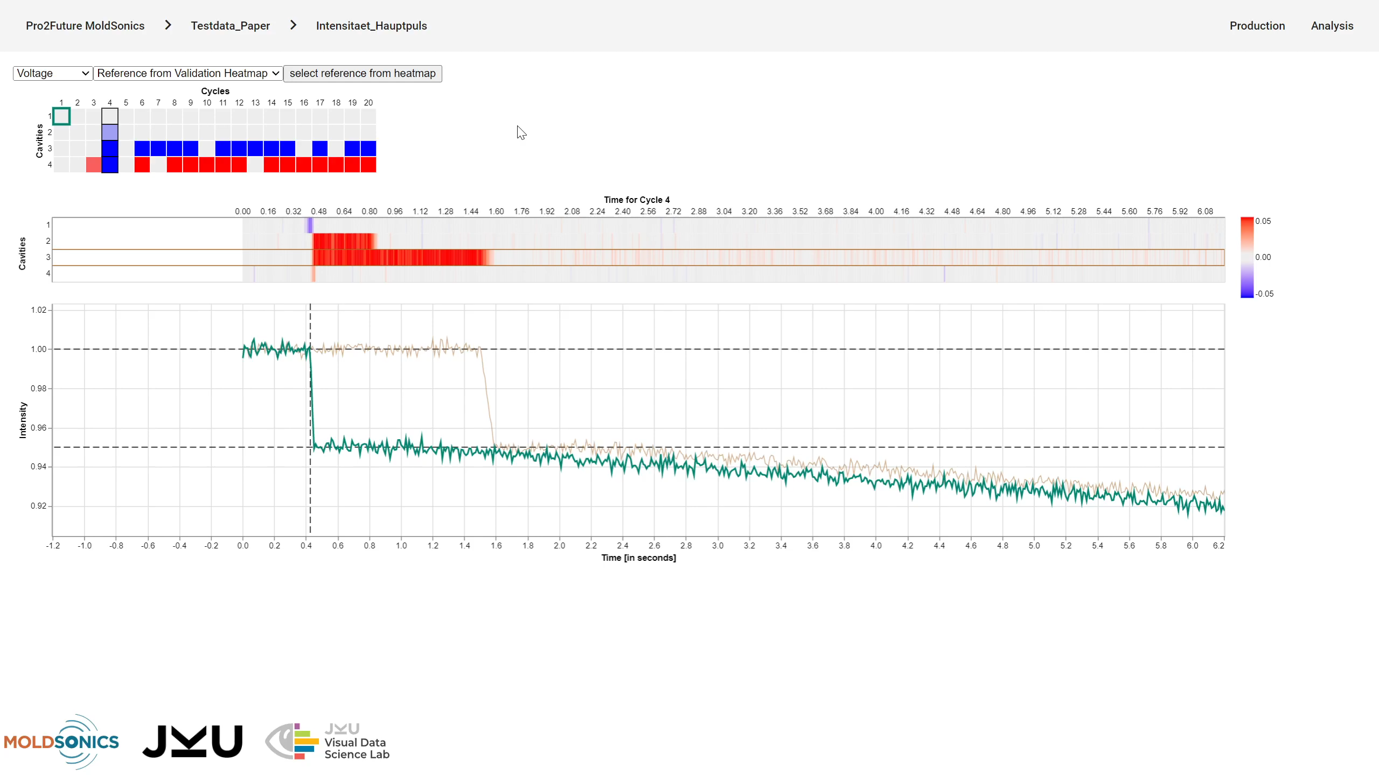
Visualization Workflow

Slide 21








Interactive Multi-View Display
Validation Heatmap
Progression Heatmap
Time Series Plot
Detailed Comparison
http://injection-molding.jku-vds-lab.at/

Slide 22
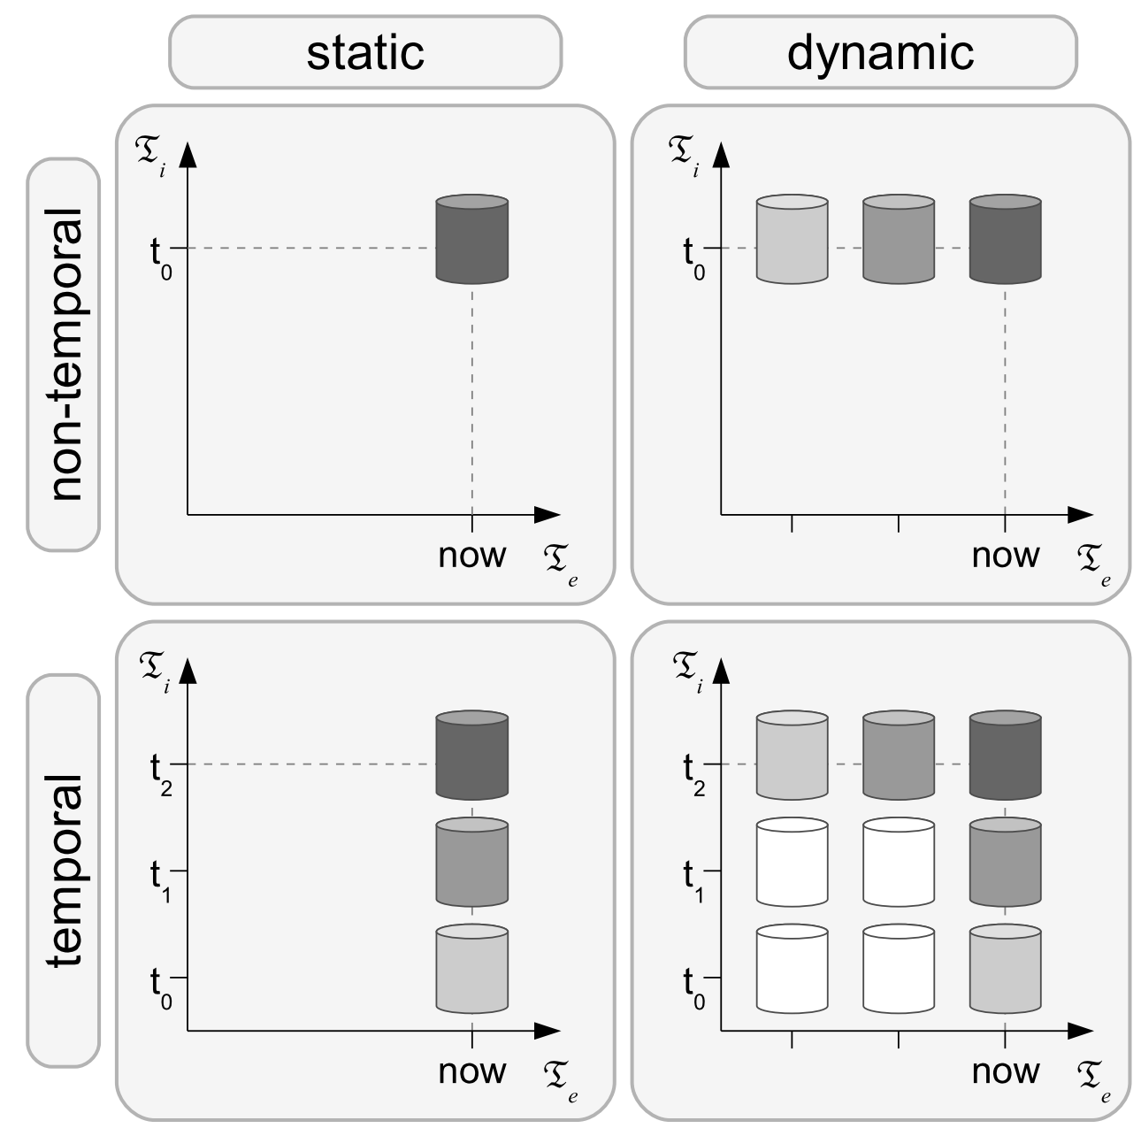
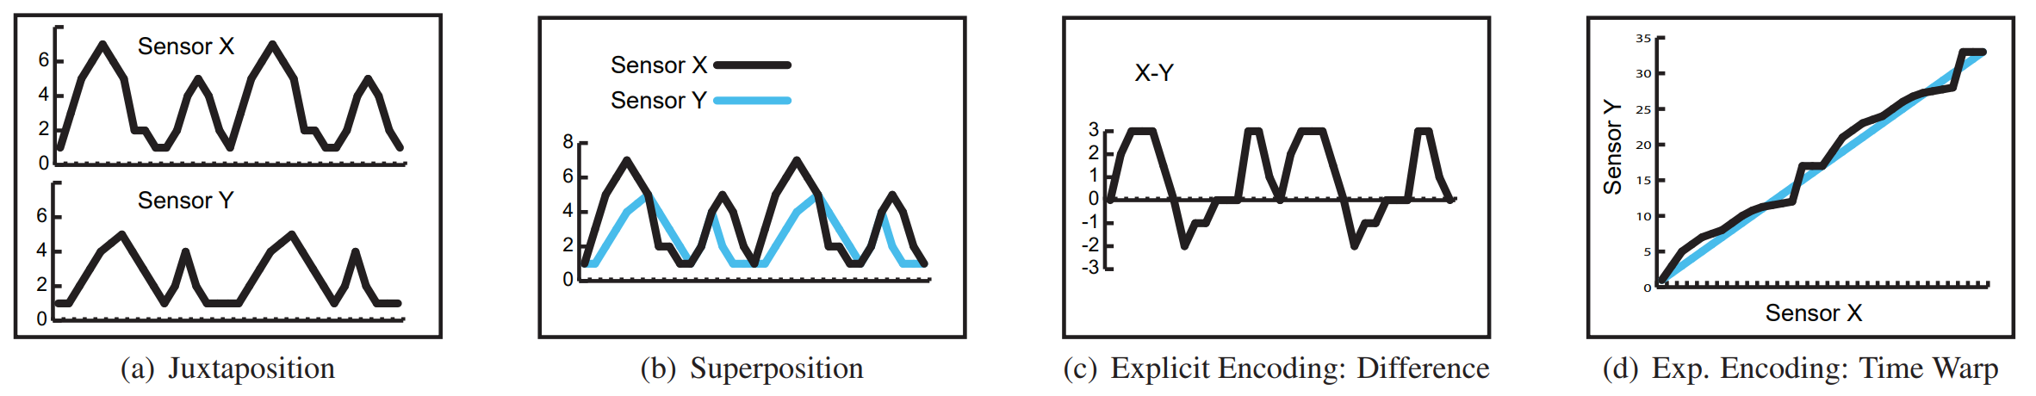
Related Work, Theory
Visualization of Time-Oriented Data
Aigner et al. (2011)
Considerations for Visualizing Comparison
Gleicher (2018)

Slide 23
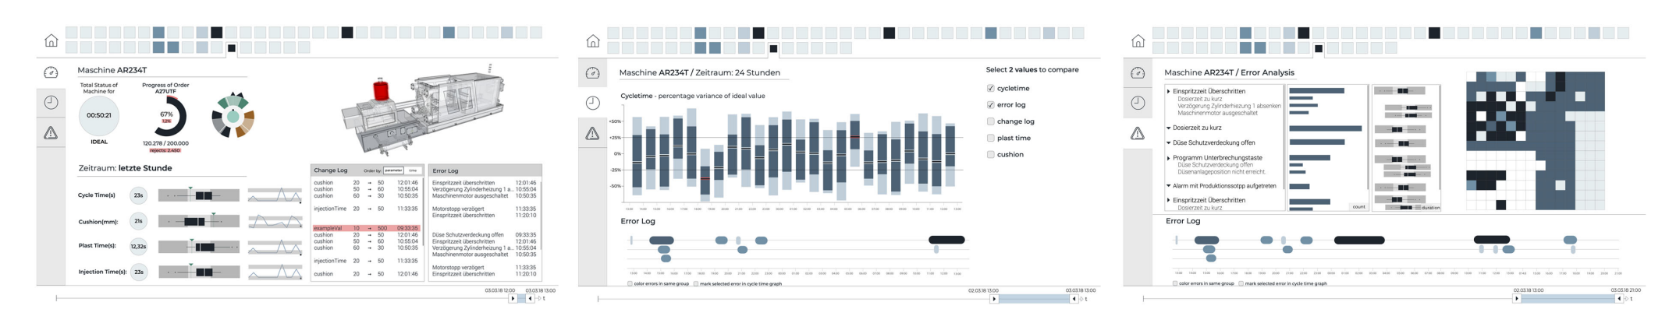
Related Work, Practical
Reflections on Visualization Research Projects in the Manufacturing Industry, Greiner BigDataVis, Cibulski et al. (2022)

Slide 24
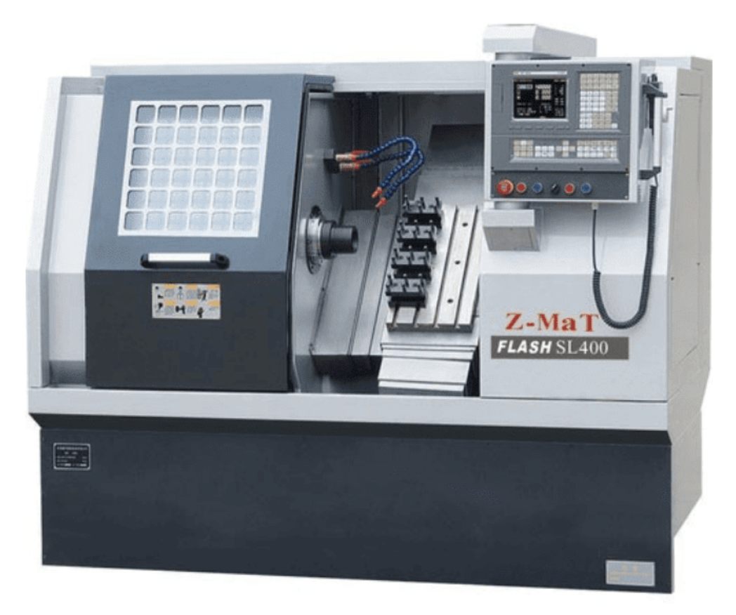
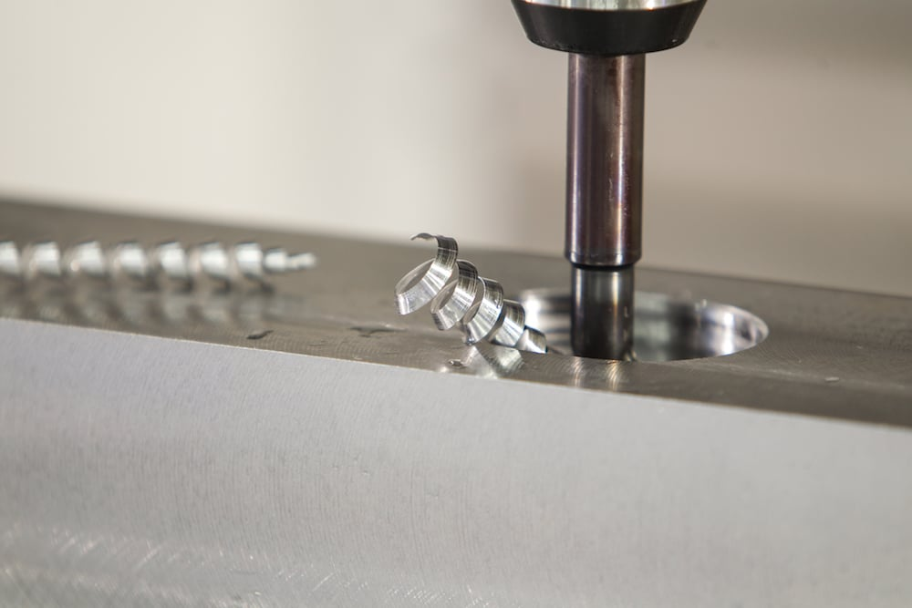
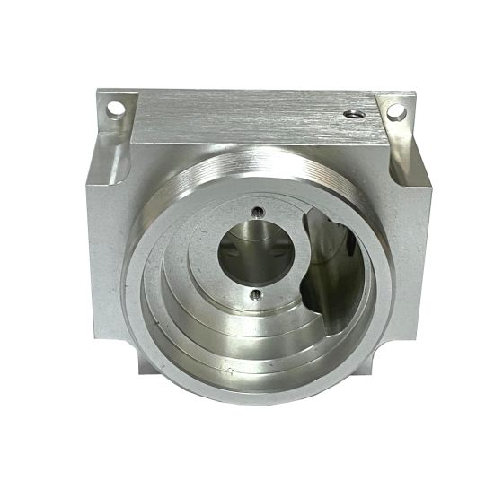
Future Work, Generalization
NC Machine
Process of machining a part
Resulting part

Slide 25
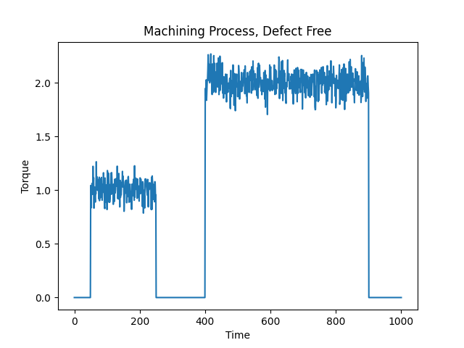
Future Work, Generalization
NC Machine
Process of machining a part
Resulting part

Slide 26
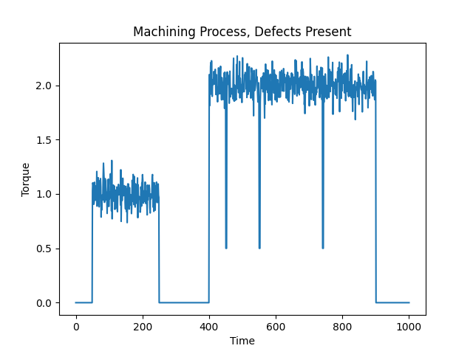
Future Work, Generalization
NC Machine
Process of machining a part
Resulting part

Slide 27
Future Work, Generalization
Down-Projection
Embedding Dimension 2
Embedding Dimension 1

Slide 28
Future Work, Generalization
Down-Projection
Embedding Dimension 2
Embedding Dimension 1

Slide 29
Future Work, Generalization
Down-Projection
Detail Comparison View
User selection
Embedding Dimension 2
Embedding Dimension 1

Slide 30
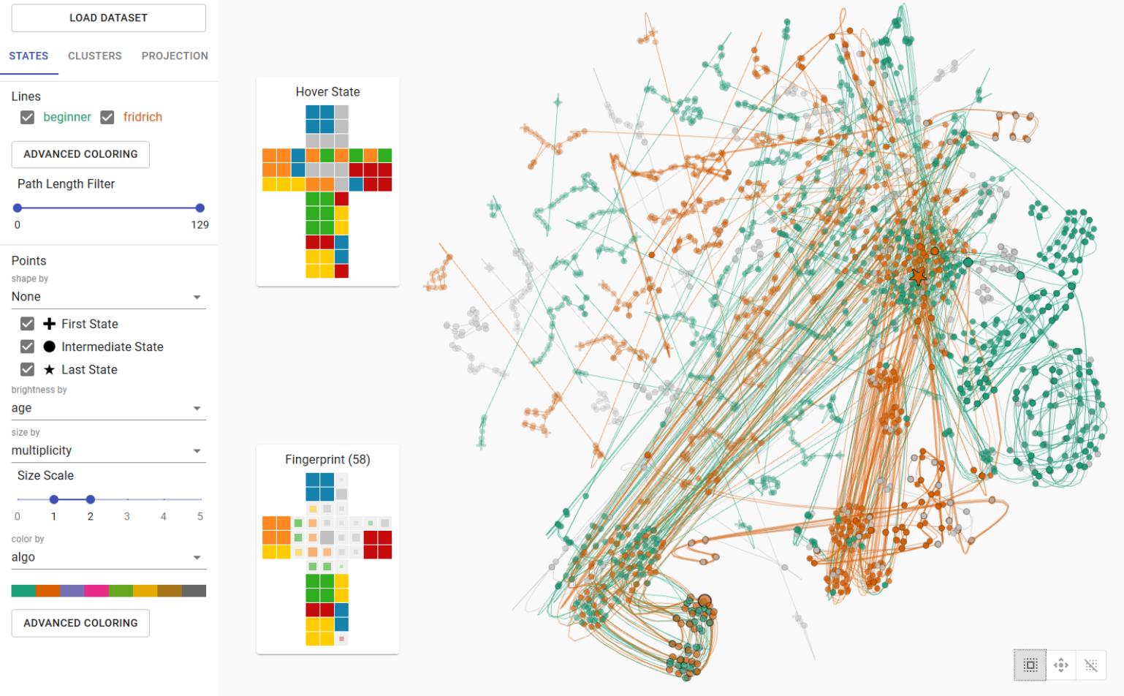
https://jku-vds-lab.at/projection-space-explorer-app/

Slide 31
Visualizing and Monitoring the Process of Injection Molding
Christian A. Steinparz, Thomas Mitterlehner, Bernhard Praher, Klaus Straka, Holger Stitz, Marc Streit
http://injection-molding.jku-vds-lab.at/
christian.steinparz@jku.at

Slide 32
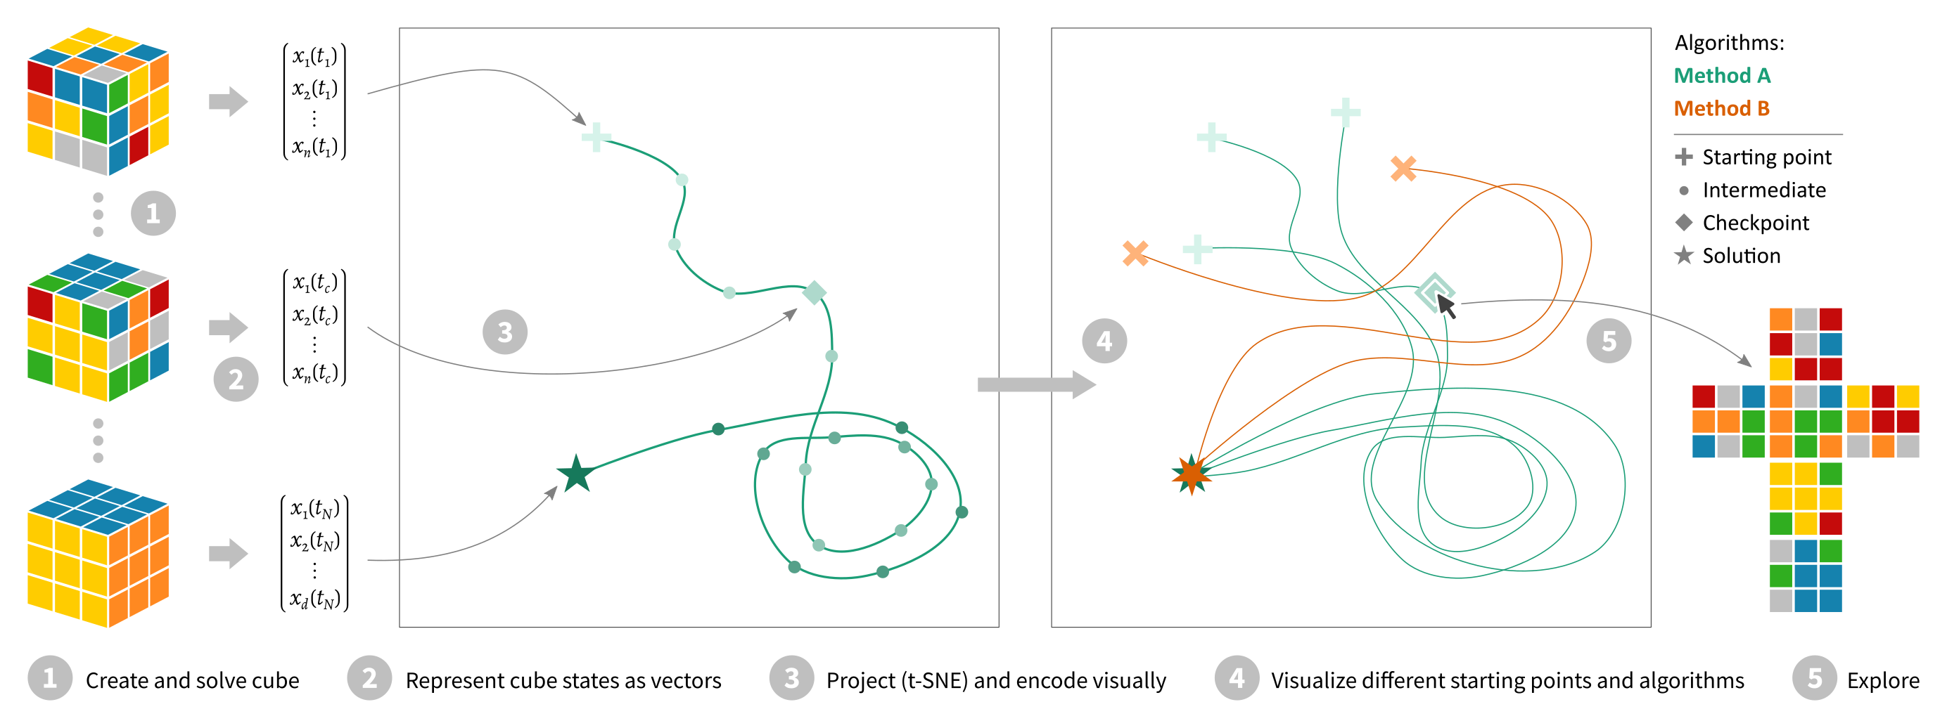
https://jku-vds-lab.at/projection-space-explorer-app/

